Slide 1

YZY Language School
Ying HAO
Yaowu HUANG
Zhiwei LI
APR 19, 2021

Slide 2

Agenda - Purpose of the System - Solution Overview - Challenges of the project - MVVM Architecture - Multiple Validations - Unit Test - UI Design - Drawing pie chart / bar chart - String Translation - Database Migration - Future Work

Slide 3
Purpose of the System
Provide desktop app for YZY Language School
- Admin and teacher can login to enable related function
- Admin can manage all courses ( create, update and delete )
- Admin can manage all user accounts (create, update and delete )
- Teacher can manage student grade of all his/her courses
- Admin and teacher can update their own profile information
Provide desktop app for student
- Guest user can register an account of student
- Guest use can search course and teacher information
- Student can login to enable related function
- Student can perform registration / cancellation of courses
- Student can manage payment

Slide 4
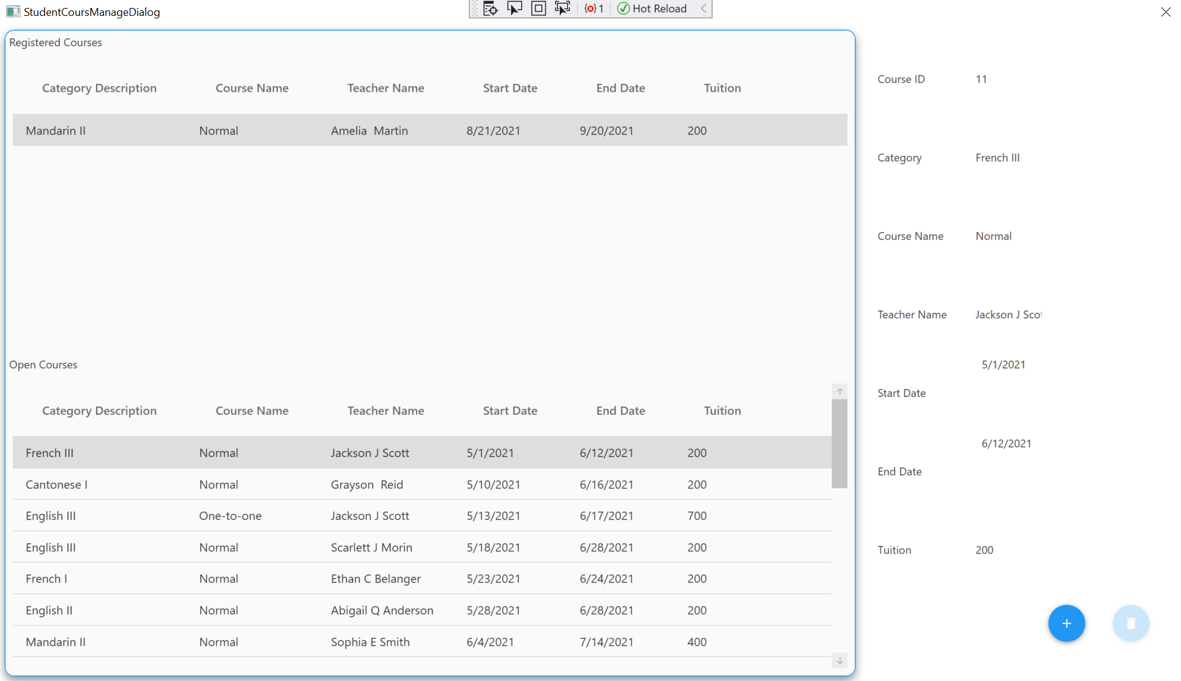
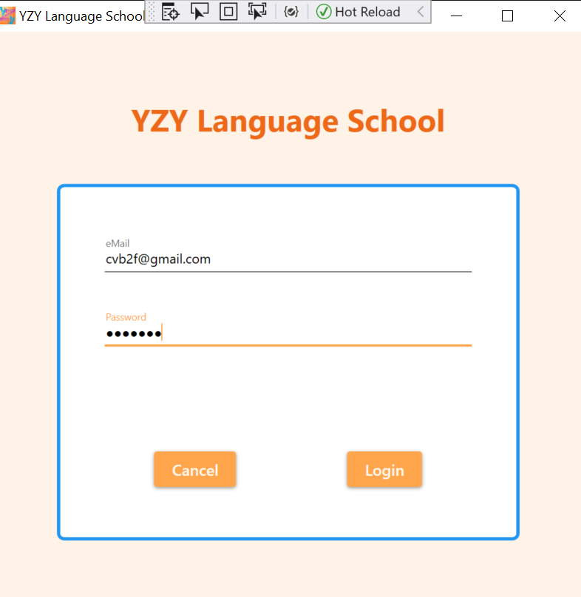
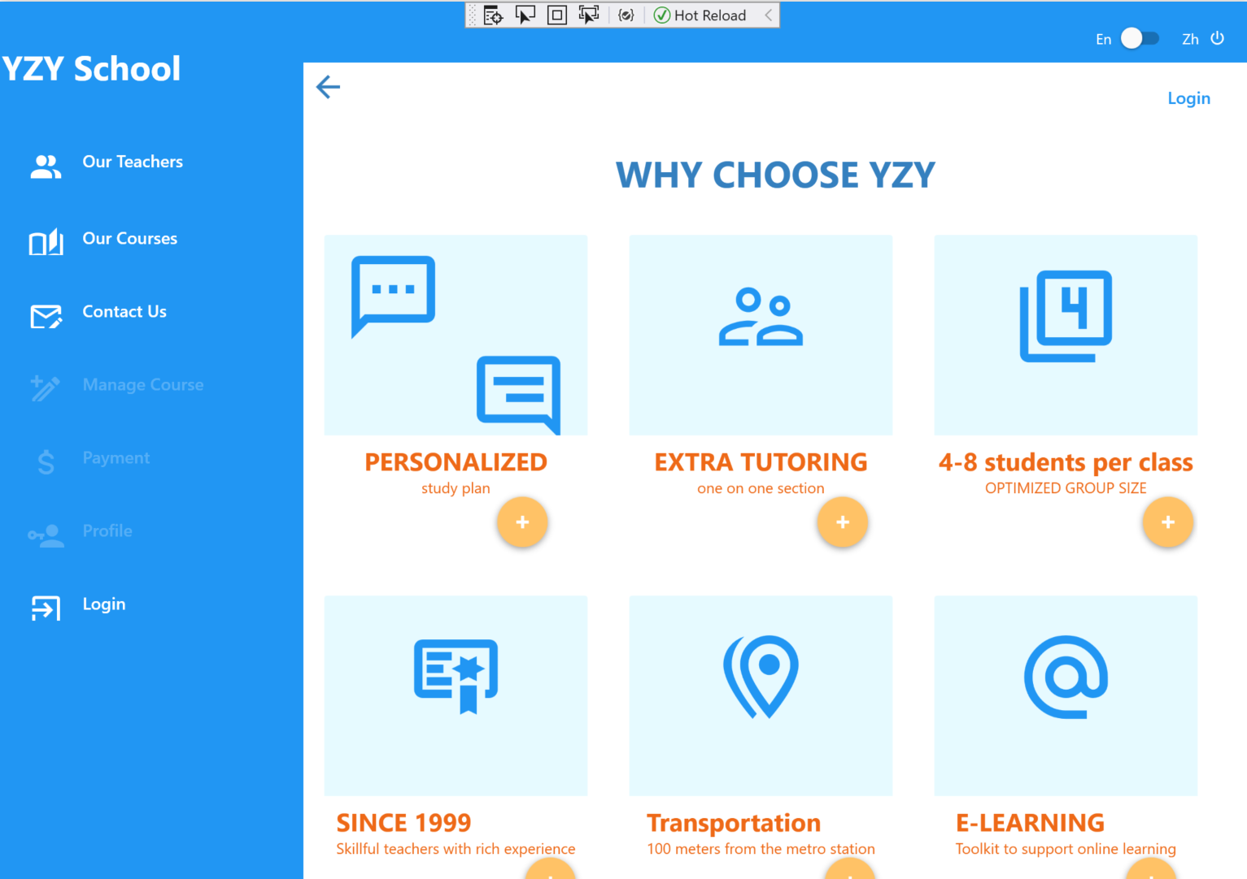
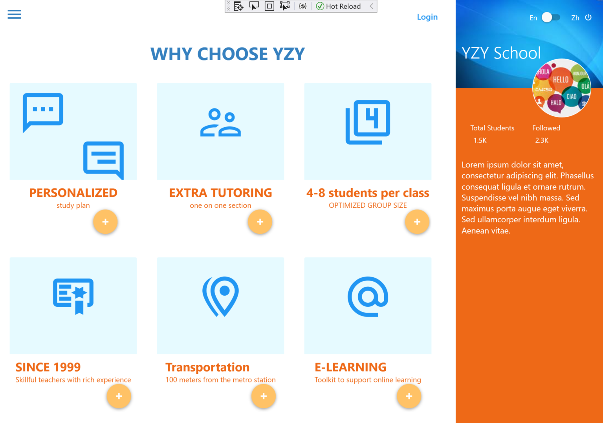
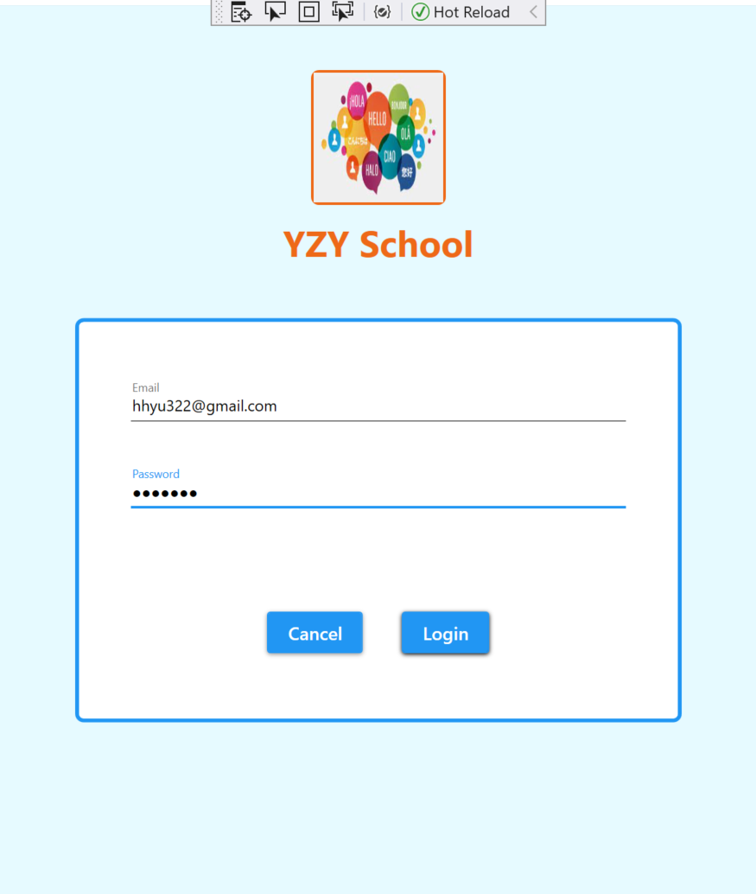
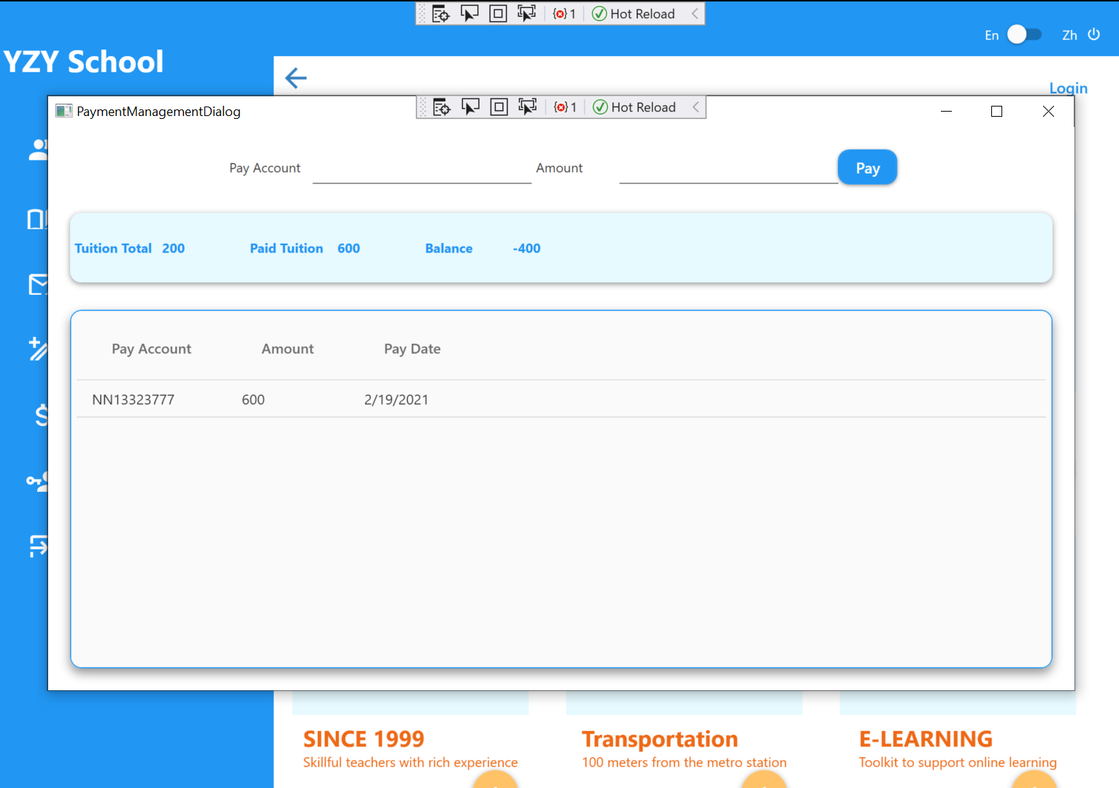
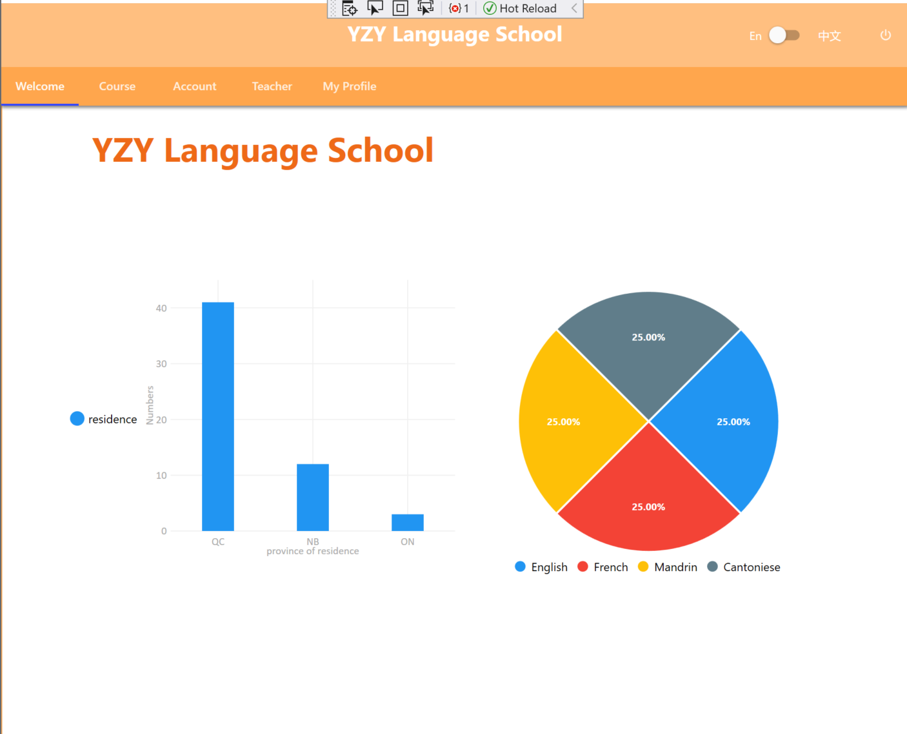
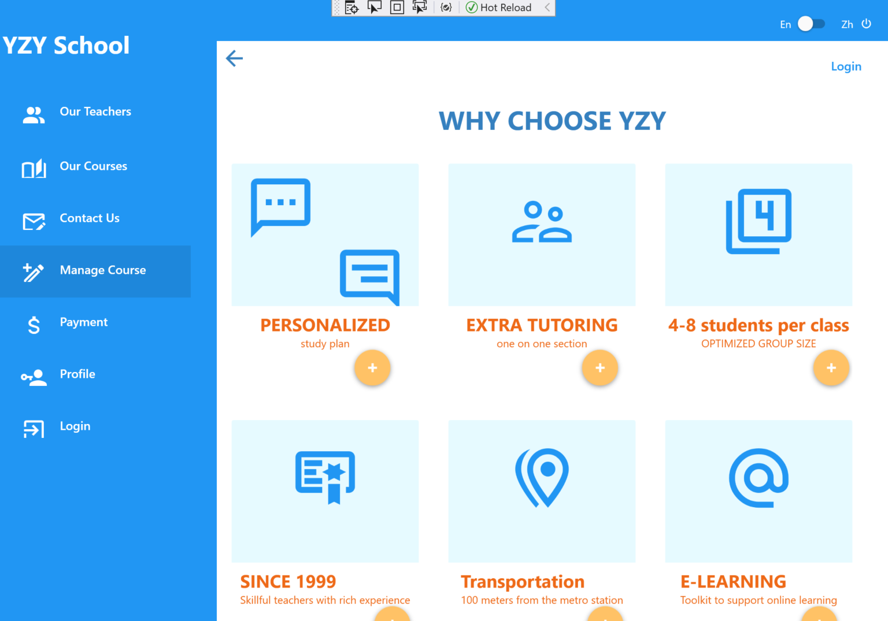
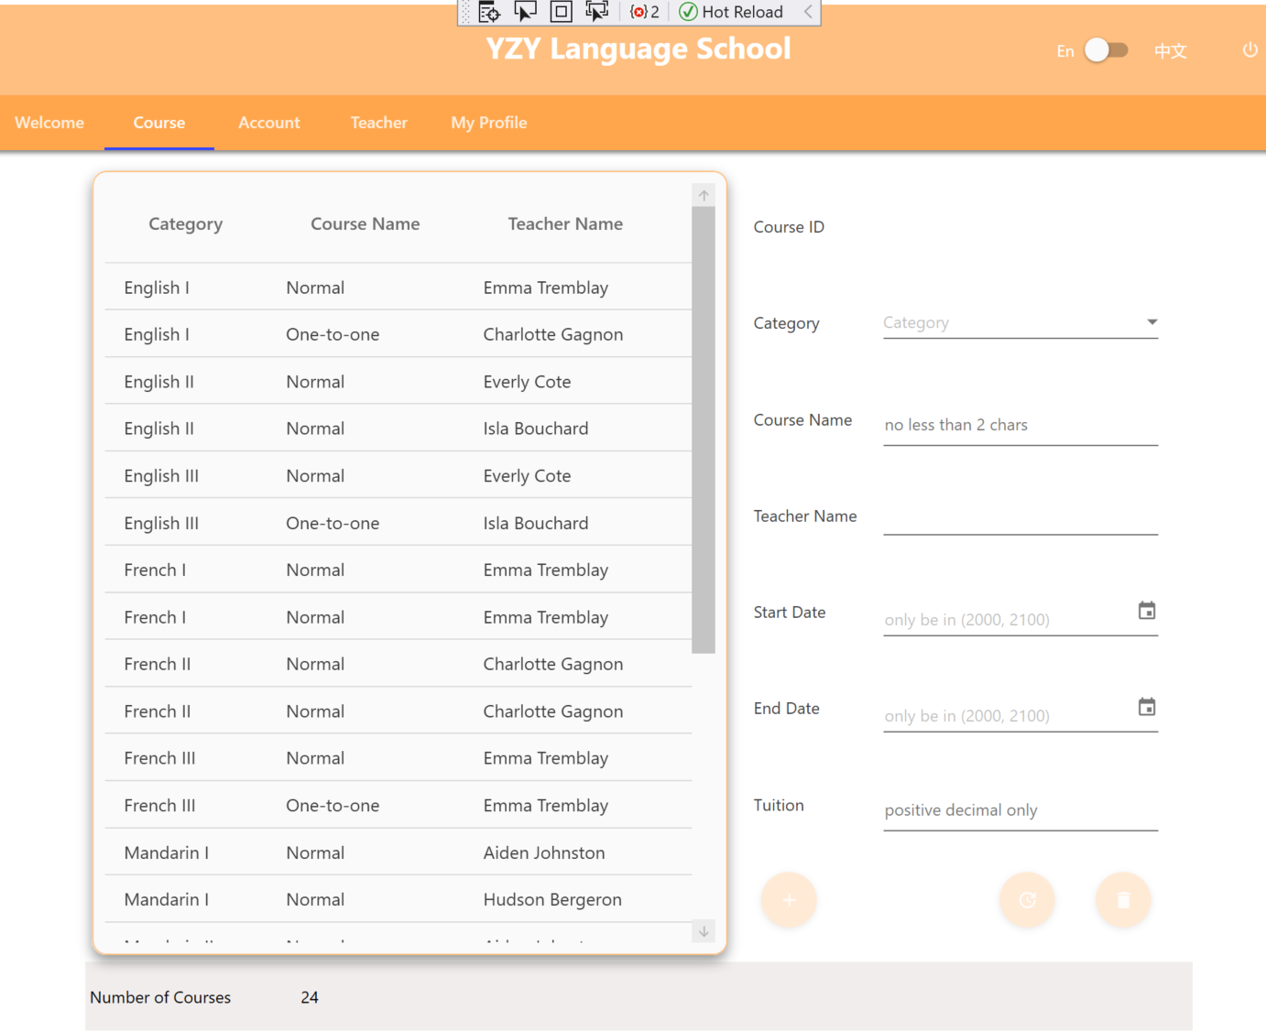
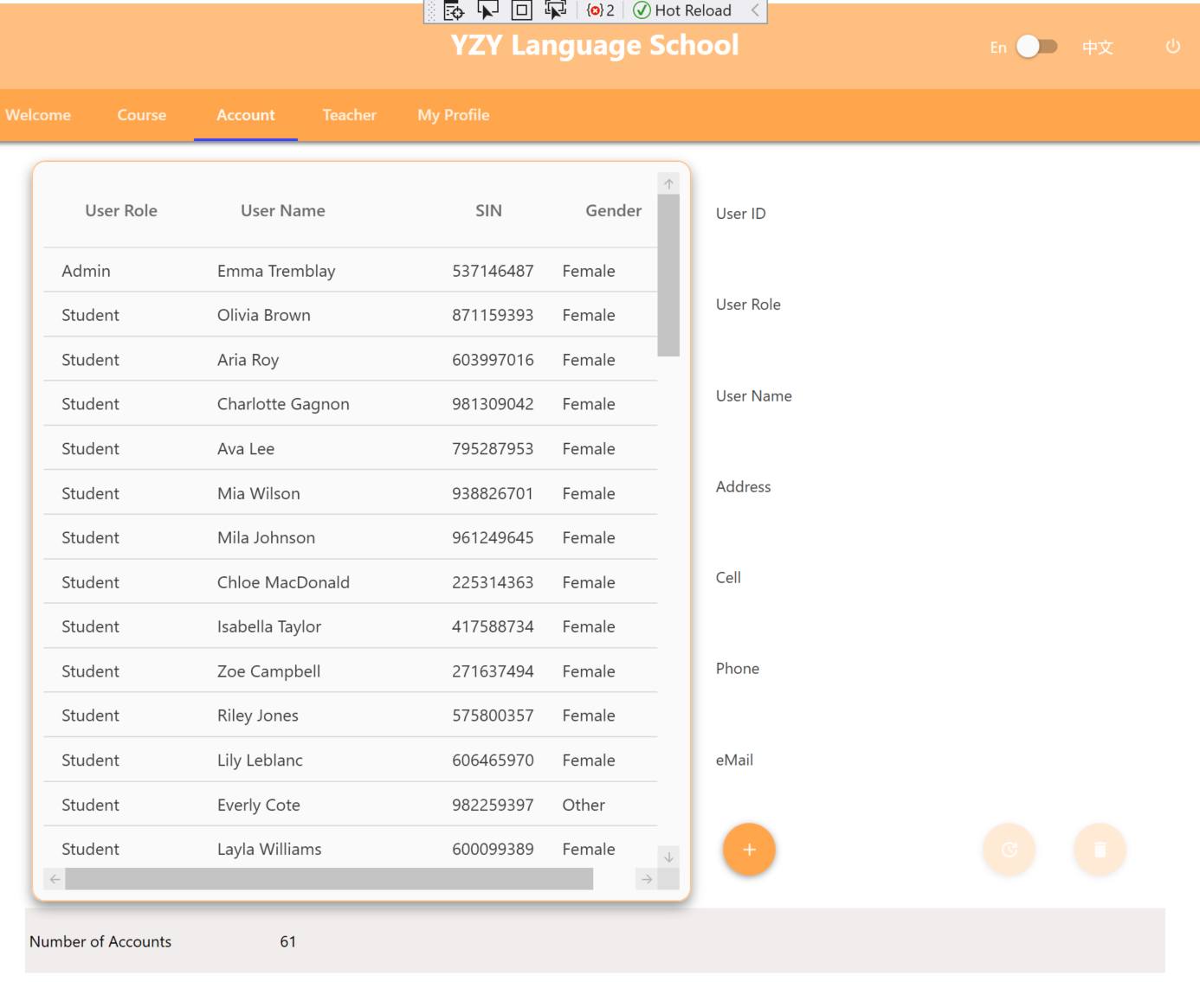
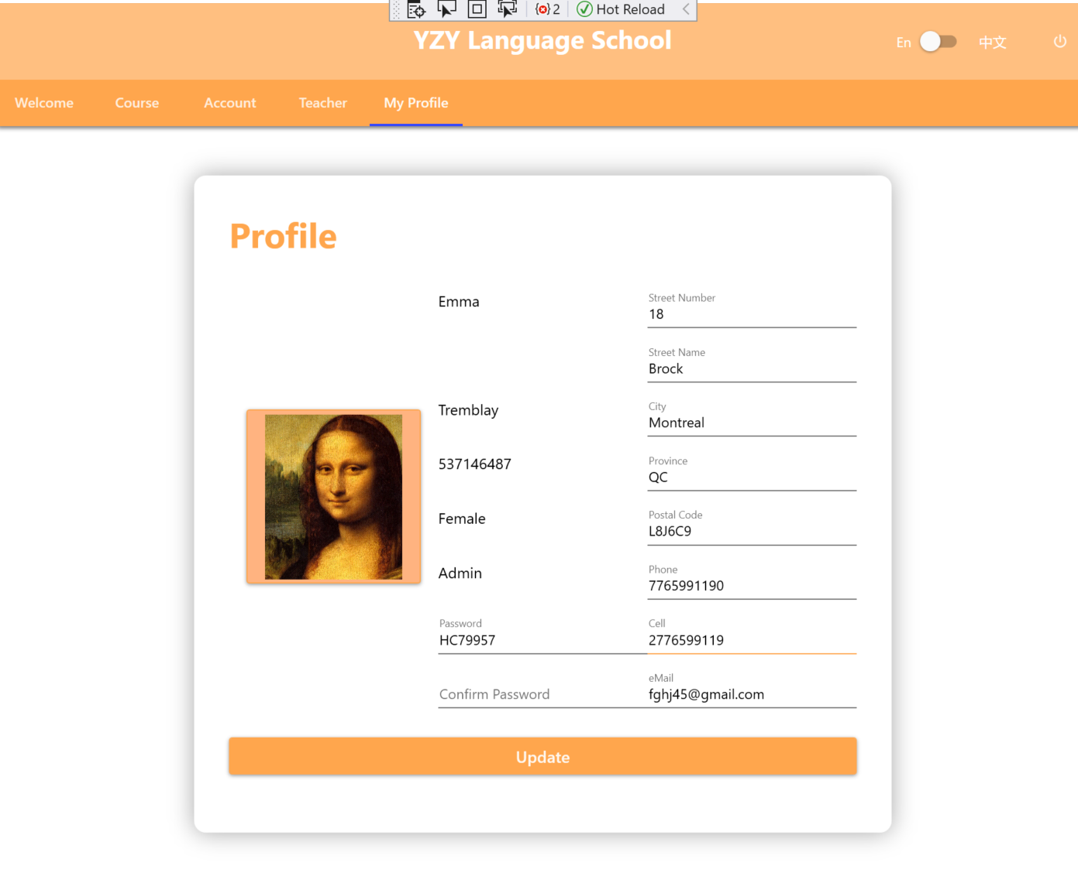
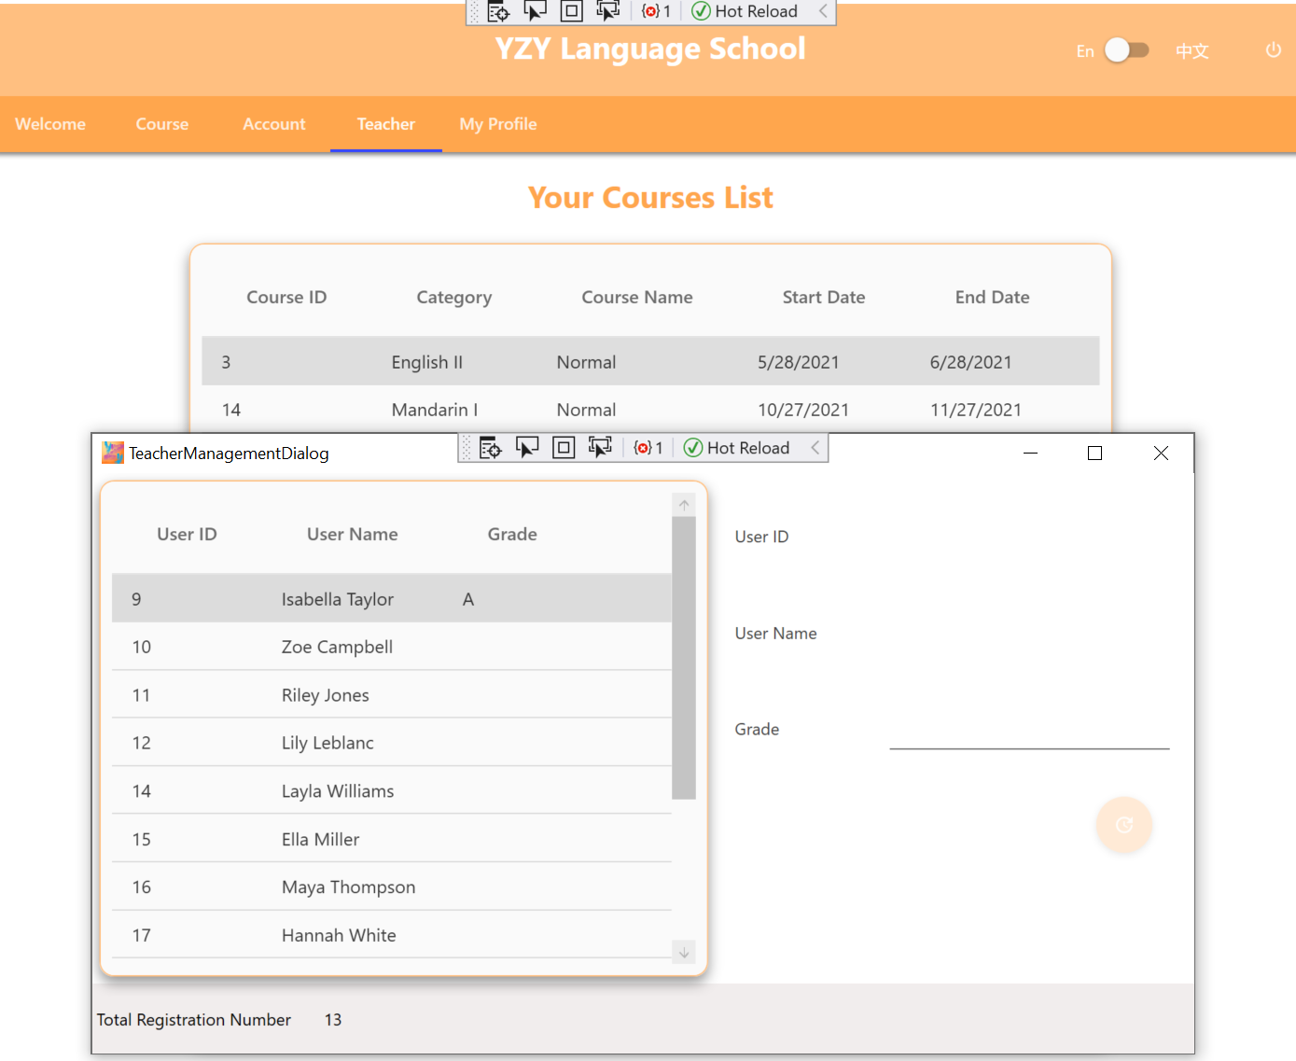
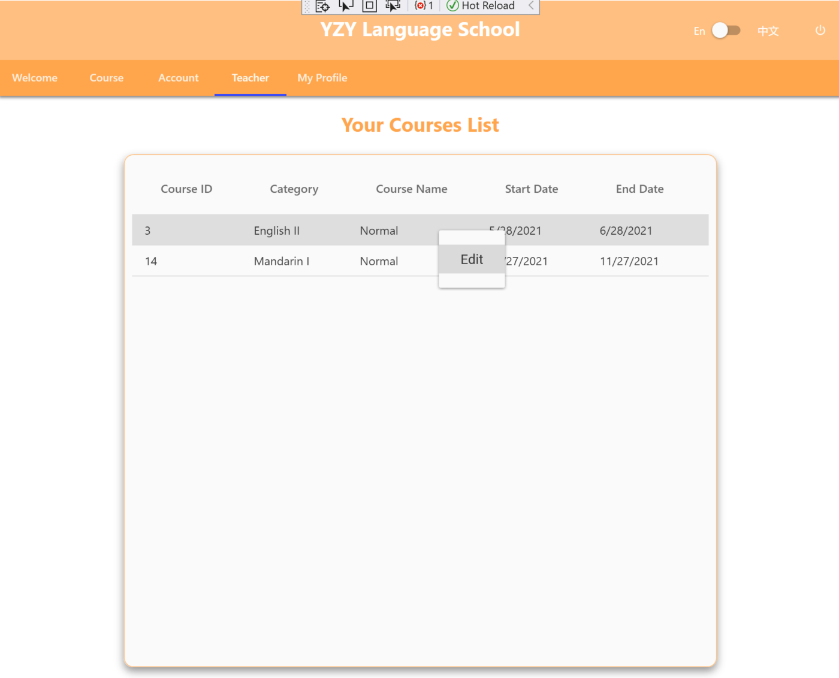
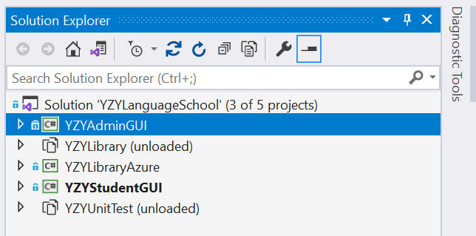
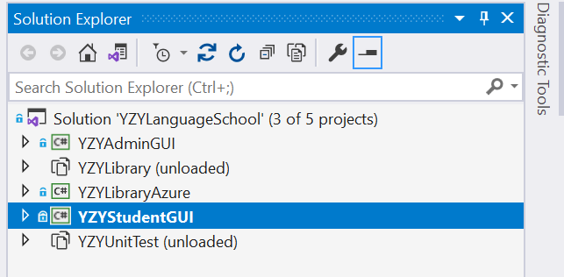
Solution Overview

Slide 5
Challenges in the first Client-Server Project
Bulk Data needs migration from local database to Azure
Database Design has to be altered for coding convenience
Database Validation conflicts with the one of Code Side
How to split coding work independently between members
How to write Unit Test cases without UI input
How to make a modern UI instead of homework style

Slide 6
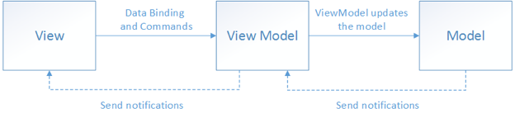
MVVM Architecture – Why?
Model (data layer) – View Model (logic layer) – View (user interface)
View is built on XAML only.
View model encapsulates the model.
View links with View Model via data binding and command binding.
The UI can be redesigned without touching the code (logic and data layers).
Unit tests can be built for the code (logic and data layers), without using UI.
Designers and developers can work independently.

Slide 7

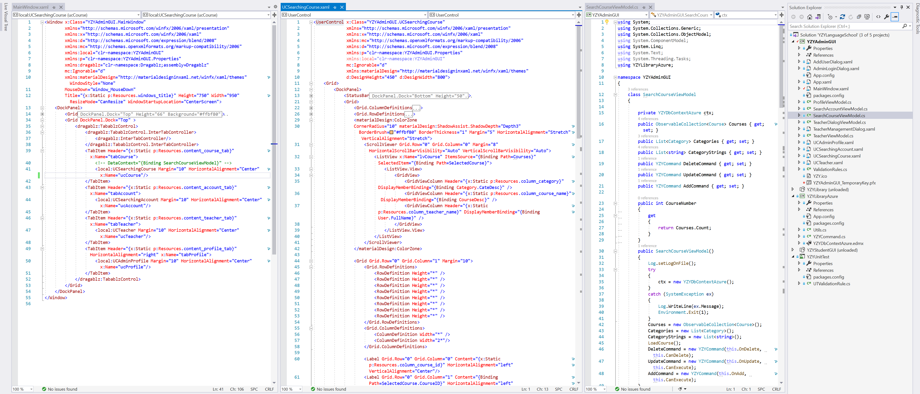
MVVM Architecture – Code Example

Slide 8

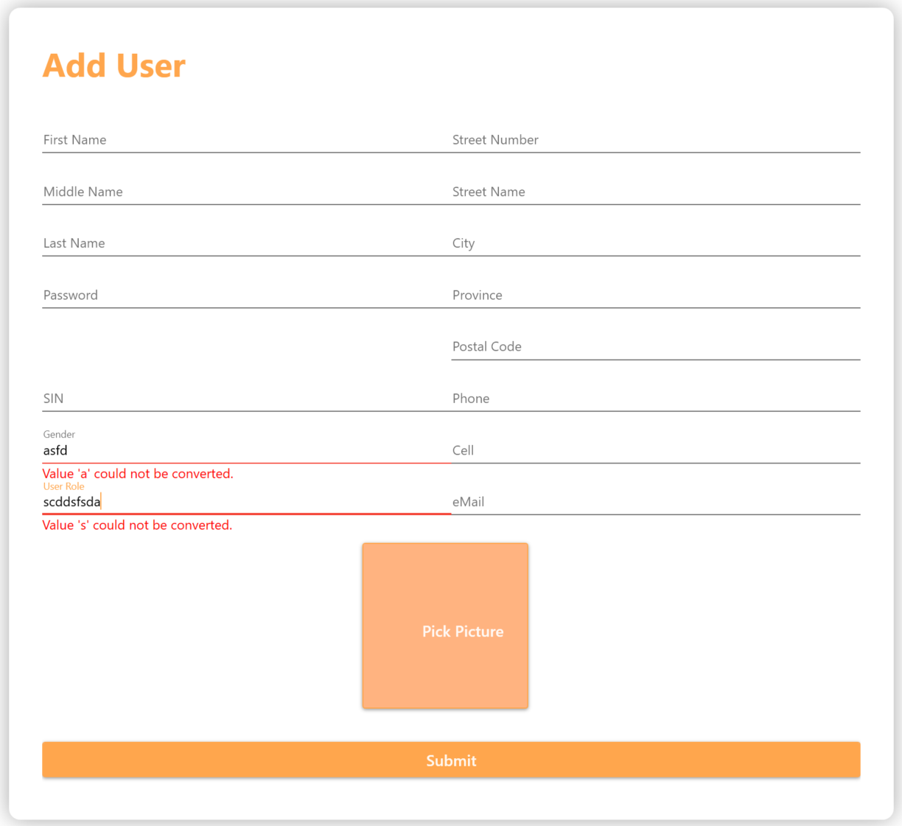
Multiple Validations
Hint information
IDataErrorInfo
Exception
ValidatesOnDataErrors
Message
Business Logic Validation
Data Format Validation
Normalization

Slide 9
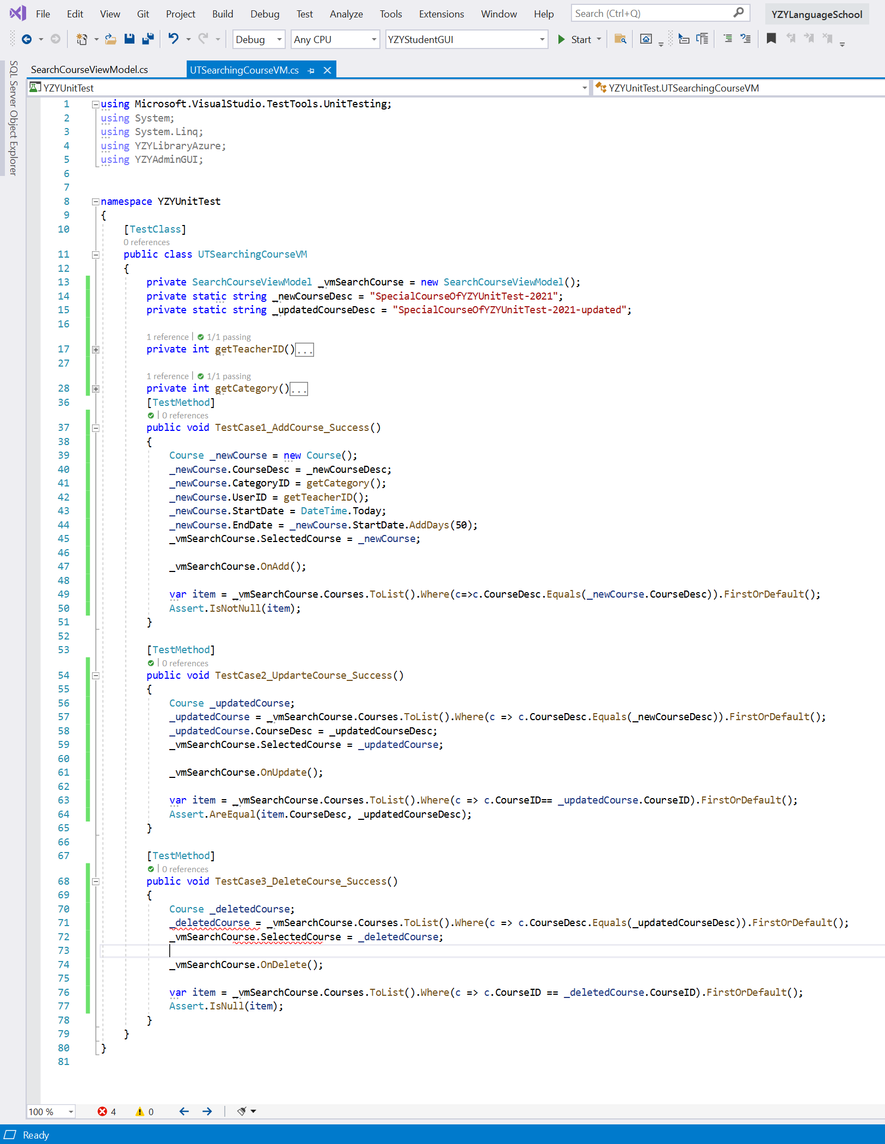
Unit Test on MVVM
View Model
Add of View Model
Update of View Model
XAML
Business Logic and Data
Delete of View Model

Slide 10

User Interface
User Controls / tab, Responsive,
Animation Effect,
Charts

Slide 11
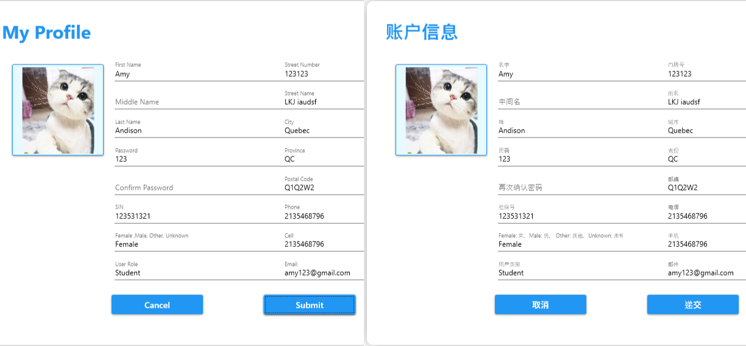
String Translation
Dictionaries
Default Culture
Switch Language

Slide 12


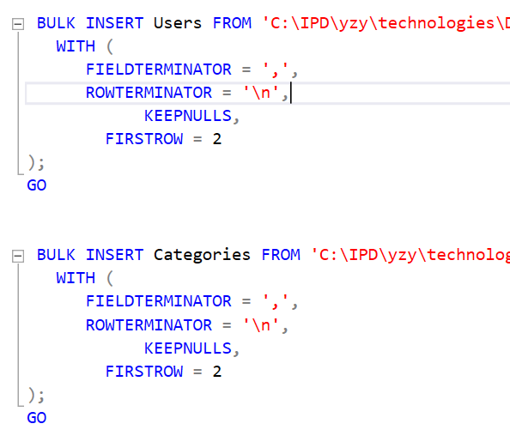
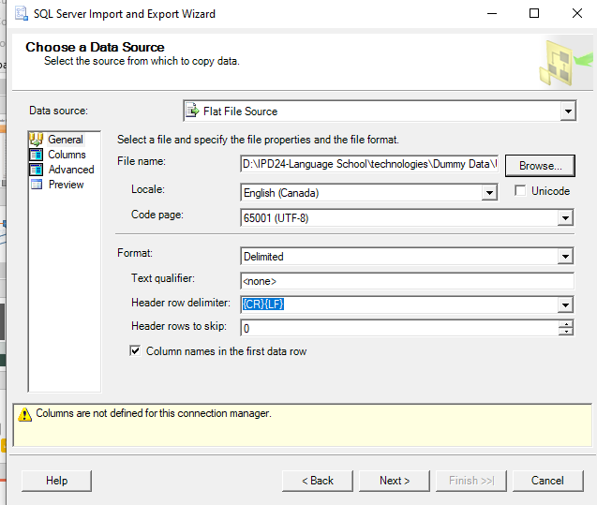
Database – Import Data from Local to Azure
SQL Server Import and Export Wizard
Bulk Insert sql as for local DB

Slide 13
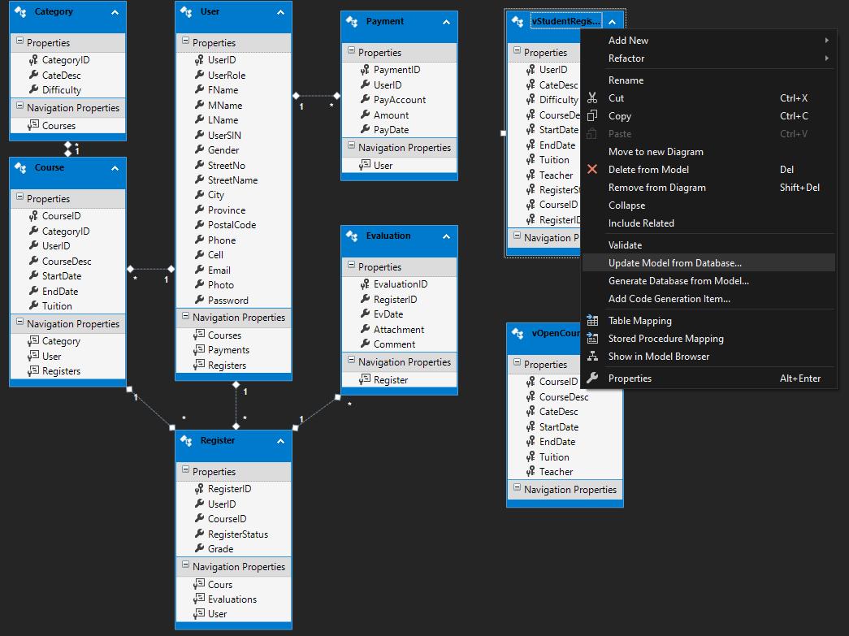
Database – DB Model Update Overwrite Codes

Slide 14
Future Work
Performance improvement
Solution to handle modified entity code on DB model update
Implement JS Payment Gateway with WPF desktop App
More complete version of localization, which cover more information like exception handling message

Slide 15
Summary
Implement project in the DB-first approach
Experience of MVVM architecture
Explore more advanced UI design (Material Design, Live Chart)
Methodology multi-language interface
Deploy and interact with Azure DB
…

Slide 16
Thank You! Merci! 谢谢！
Link to project resources:
Bitbucket – Source code
Trello – Project management record
Azure -- Database
One drive – Installation file

Slide 17
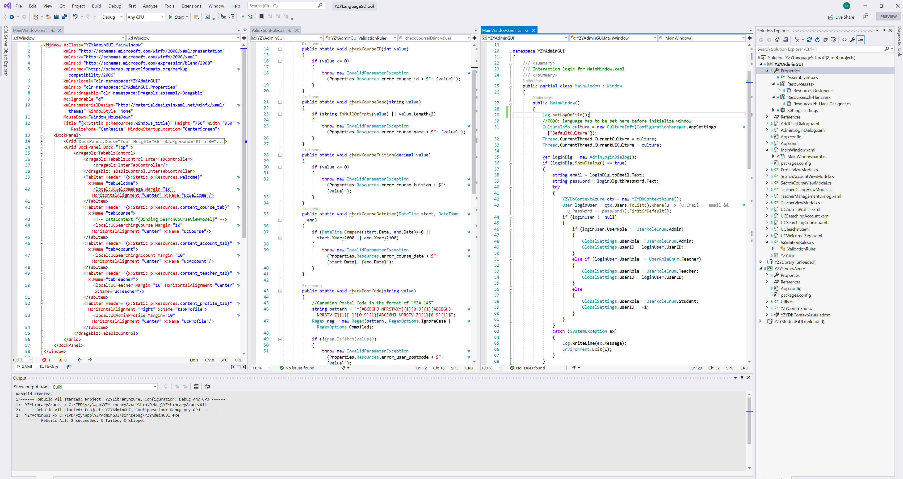
String Translation
Use translation resources in XAML
Use translation resources in c# code
Set language culture (configuration) before InitializeComponent()
Resources in Properties

Slide 18
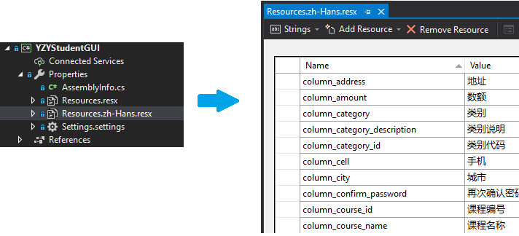
String Translation – Build Dictionary
Build resource files (.resx) in project properties
Build name/value reference

Slide 19
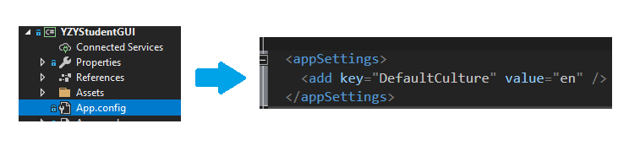
String Translation – Set Default Culture
Add Default Culture in App.config

Slide 20
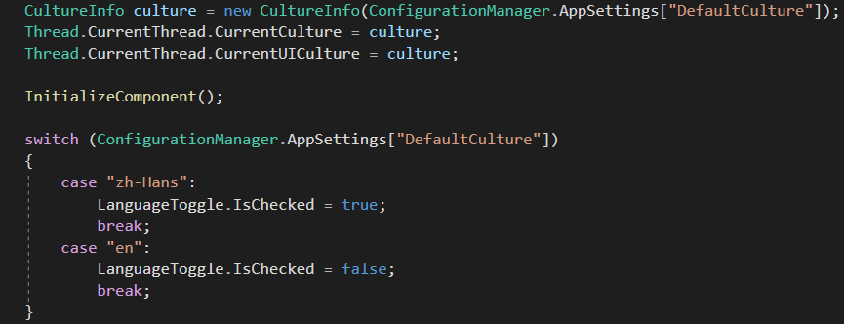
String Translation – Switch Default Culture
Based on the UI, Assign value to Default Culture and change language

